Slide 1
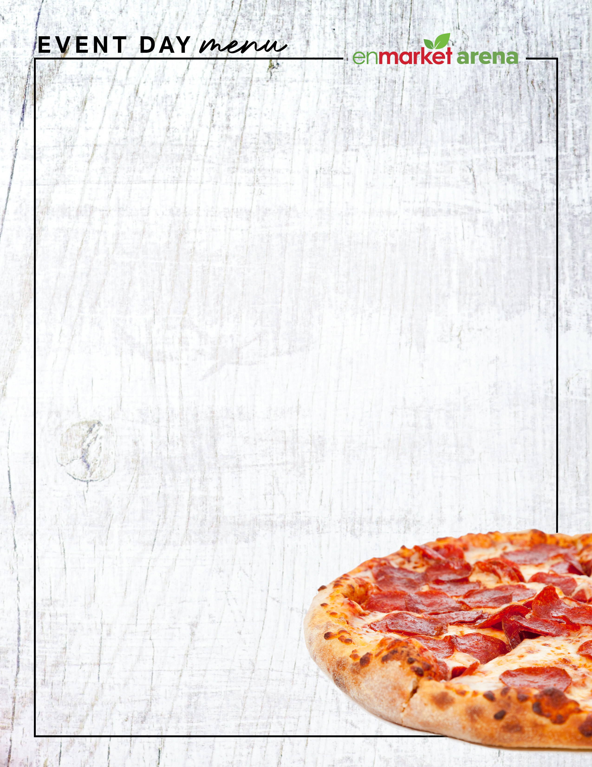
ALL SELECTIONS SERVE APPROXIMATELY 6 PEOPLE
CLASSIC POPCORN^{G V} | 25
Endless supply of butter-flavored popcorn in a souvenir bucket
BOTTOMLESS SNACK ATTACK | 40
Spicy snack mix, pretzel twists, gourmet nuts and kettle chips
SALSA TRIO G V | 35
Pico de gallo, salsa rojo, black bean salsa & corn tortilla chips
BAVARIAN SOFT PRETZEL STICKS | 35
Served warm with signature beer cheese sauce
CLASSIC CHEESE PIZZA V | 30
Crispy, crunchy, cheesy to the edge slices, topped with premium mozzarella cheese blend
PEPPERONI PIZZA | 35
Crispy, crunchy, cheesy to the edge slices, topped premium mozzarella cheese & pepperoni
FRITA FIESTA PLATTER | 90
CHOOSE ANY 5: Onion rings, stuffed jalapenos ,mac and cheese bites, chicken tenders, mozzarella sticks, spicy cauliflower, fried shrimp, and French fries.
CHICKEN TENDERS |75
BBQ sauce & buttermilk ranch dressing
HOT DOGS | 45
8 all-beef frank served with peppers, onions, sauerkraut,
traditional rolls & condiments
LOADED FRIES | 45
Pico de gallo, jalapenos, corn bean salsa,
sour cream and cheese
add chili | 10
CANDY SHOP | 60
Sweet goodies for the sweet tooth
ASK YOUR SERVER FOR THE CHEF'S VEGETARIAN CHOICE OF THE DAY
^{G} GLUTEN-FREE | ^{V} VEGETARIAN | ^{N} CONTAINS NUTS

